Slide 1
PROJECT-2-Cloud Storage & Backup
CodeVedx Cloud Computing Internship

Slide 2
Objectives & Cloud Services
Service-used : Amazon Web Services(AWS) S3
Key Objectives : Configure secure storage with automated backup and file versioning

Slide 3
Implementation Steps
Created S3 Bucket:
Enabled S3 Bucket Versioning
Uploaded Primary and Updated revisions of objects to confirm version retention

Slide 4
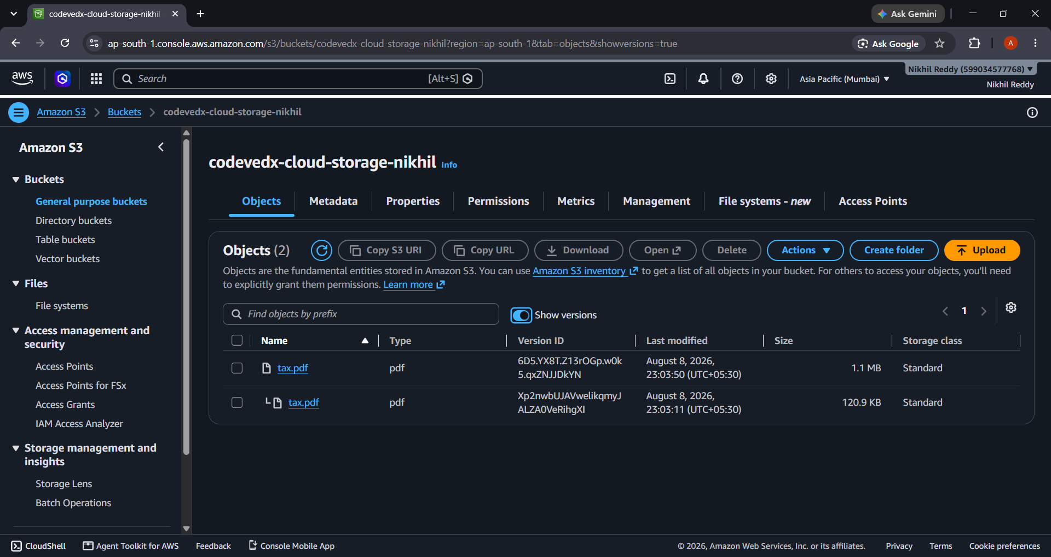
Verification and Conclusion
Successfully verified that AWS tracks multiple Version IDs for Updated files

